Slide 1
S3 GRAPHIC COMMUNICATION
Colour Theory and Rendering

Slide 2
Learning intentions & success criteria
Learning Intentions
Introduction to colour theory and pencil rendering.
Success Criteria
I understand and can explain the difference between primary, secondary and tertiary colours.
I understand and can explain the different terms used to describe colour theory, such as advancing, receding, tint, tone and mood.

Slide 3
Colour theory
Colour theory is both the science and art of using colour. It explains how humans perceive colour, and the visual effects of how colours mix, match or contrast with each other.
We will be using colour theory throughout graphic communication, particularly later on in the desktop publishing unit.
In colour theory, colours are organised on a colour wheel and grouped into different categories.

Slide 4
The Colour Wheel
The colour wheel is made up of three parts:-
Primary Colours
Secondary Colours
There are:-
3 primary colours
3 secondary colours
6 tertiary colours
Tertiary Colours
BACK TO MENU

Slide 5
Primary Colours
There are THREE PRIMARY COLOURS in the colour wheel:-
YELLOW
BLUE
RED
These are the three colours that are used to create ALL of the other colours in the colour wheel by mixing TWO of them together.
BACK TO MENU

Slide 6
Secondary Colours
There are THREE SECONDARY COLOURS in the colour wheel:-
GREEN
ORANGE
(blue + yellow = green)
(red + yellow = orange)
VIOLET
(red + blue = violet)
SECONDARY COLOURS are made by mixing TWO PRIMARY COLOURS together in equal quantities.
BACK TO MENU

Slide 7
Tertiary Colours
TERTIARY COLOURS are made by mixing a PRIMARY COLOUR and a SECONDARY COLOUR together in equal measurements.
GREEN-YELLOW
YELLOW-ORANGE
BLUE-GREEN
RED-ORANGE
VIOLET-BLUE
RED-VIOLET
BACK TO MENU

Slide 8
Relationship of the Colour Wheel
The colour wheel shown below was designed as a way of showing how the colours relate to each other.
Think of the Primary Colours as the number 1.
To make a secondary colour you add two primary colours together...
e.g. 1+1=2
Think of the Secondary Colours as the number 2 that you have just made and add it to a Primary Colour (1)...
e.g. 2+1=3
This is your Tertiary Colour.
2
2
1
3
1
1
You will notice that the tertiary colours are placed in-between the primary colours and the secondary colours that were used to make it.
BACK TO MENU

Slide 9
HARMONY & CONTRAST
BACK TO MENU

Slide 10
Harmony
In visual experiences, harmony is something that is pleasing to the eye.
In Graphic Communication harmony is created when colours close to each other on the outside of the colour wheel are used together.
e.g.
Harmonious colours of yellow would be green-yellow and yellow-orange.
Harmonious colours of red would be red-orange and red-violet.
Harmonious colours of violet-blue would be blue and violet.
BACK TO MENU

Slide 11
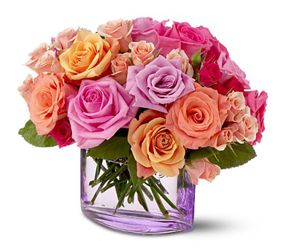
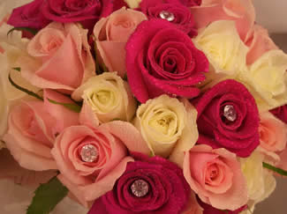
Harmony
BACK TO MENU

Slide 12
Contrast
In Graphic Communication contrasting colours are known as COMPLEMENTARY COLOURS. They are found opposite each other on the outside of the colour wheel.
e.g.
The contrast of YELLOW is VIOLET.
The contrast of ORANGE is BLUE.
The contrast of GREEN is RED.
The contrast of GREEN-YELLOW is RED-VIOLET.
BACK TO MENU

Slide 13
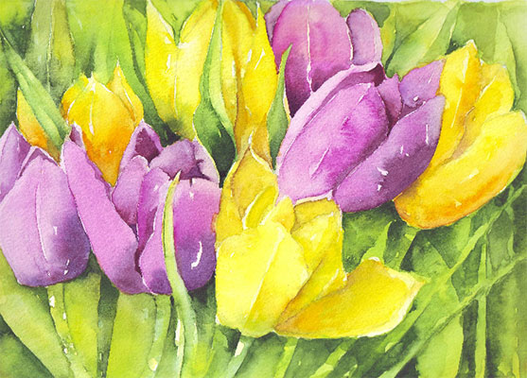
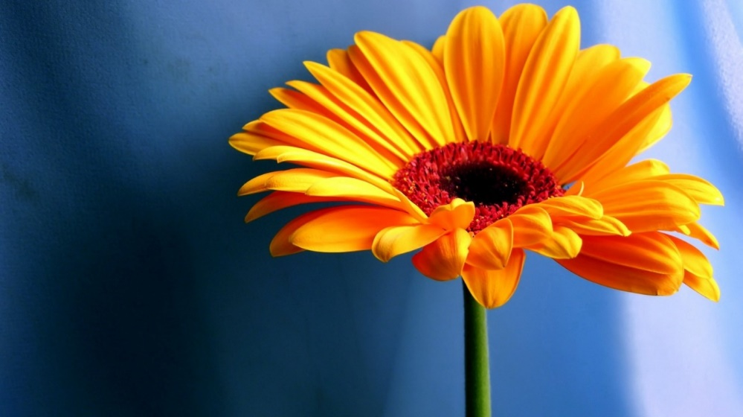
Contrast
BACK TO MENU

Slide 14
WARM & COOL COLOURS
BACK TO MENU

Slide 15
Warm Colours
WARM COLOURS are REDS, YELLOWS and ORANGES and give the feeling of warmth.
They are also known as ADVANCING COLOURS because they appear CLOSER to the viewer than other colours.
e.g. If you painted you painted your bedroom in warm colours then it would seem warm but because they are also advancing colours the room would look smaller because the walls would appear closer to the viewer.
BACK TO MENU

Slide 16
Cool Colours
COOL COLOURS are BLUES, VIOLETS and GREENS and give the feeling of cold. The opposite of warm colours.
They are also known as RECEDING COLOURS because they appear FURTHER AWAY from the viewer than other colours.
e.g. If you painted you painted your bedroom in cool colours then it would seem cold but because they are also receding colours, the room would look larger because the walls would appear further from the viewer.
BACK TO MENU

Slide 17
TONE, TINTS & SHADES
BACK TO MENU

Slide 18
Flat Tone
TONE is the word we use to describe the STRENGTH or WEAKNESS of a colour. Every colour has a huge range of tones grading from a very light and weak tone of the colour to a very dark and strong tone of the colour.
FLAT TONE is were you have one colour ranging from light tones to dark tones but you can clearly see where the first tone ends and the next tone begins.
light
dark
BACK TO MENU

Slide 19
Graded Tone
GRADED TONE is were you have one colour ranging from light tones to dark tones but you cannot clearly see where the first tone ends and the next tone begins. As the name suggests the colour gradually goes from light to dark.
light
dark
BACK TO MENU

Slide 20
Tints & Shades
TINTS and SHADES are used to create yet more colours, and are generally used by designers to create different moods.
A TINT is created by adding WHITE to a colour.
A SHADE is created by adding BLACK to a colour.
BACK TO MENU

Slide 21
COLOUR & COMMUNICATION
BACK TO MENU

Slide 22
Colour Function
Colour is used widely in the world of communication e.g.
As symbols e.g. FLAGS
To give instructions e.g. TRAFFIC LIGHTS
To show a group identity e.g. IN TEAM COLOURS
To organise and identify e.g. COLOUR CODING
To promote businesses e.g. COMPANY LOGOS
To promote sales e.g. PACKAGING COLOURS
BACK TO MENU

Slide 23
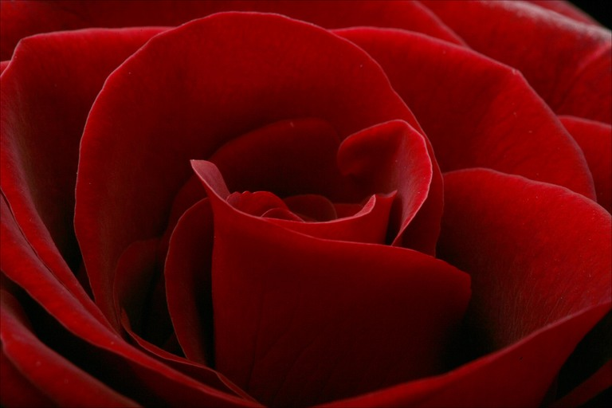
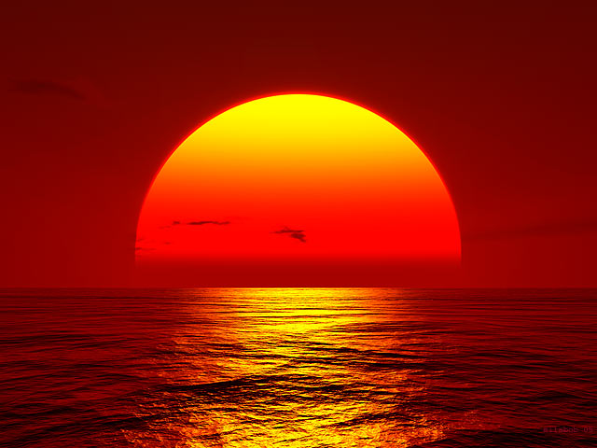
Colour & Moods
Different colours can create different moods and feelings. Designers take time in choosing the right colour schemes for each different project that they are working on, so as to select the right colours that will convey the atmosphere they want to create.
RED
ORANGE
Warm, exciting, vibrant, passionate, dangerous, active, revolutionary, aggressive, courageous, festive
Warm, happy, sunny, appetising, energy
BACK TO MENU

Slide 24
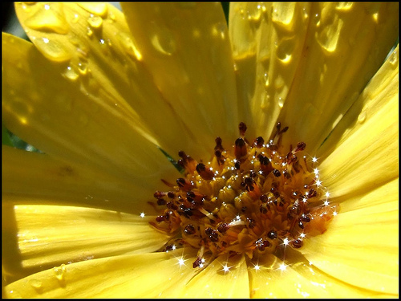
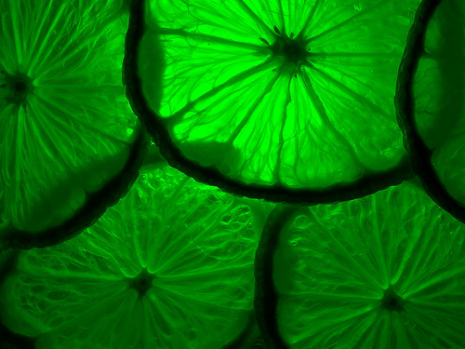
Colour & Moods
YELLOW
GREEN
Warm, happy, sunny, lively, cheerful, glowing, sparkling, bright
Cool, restful, natural, safe, calm, soothing, fresh, clean, quiet, informal
BACK TO MENU

Slide 25
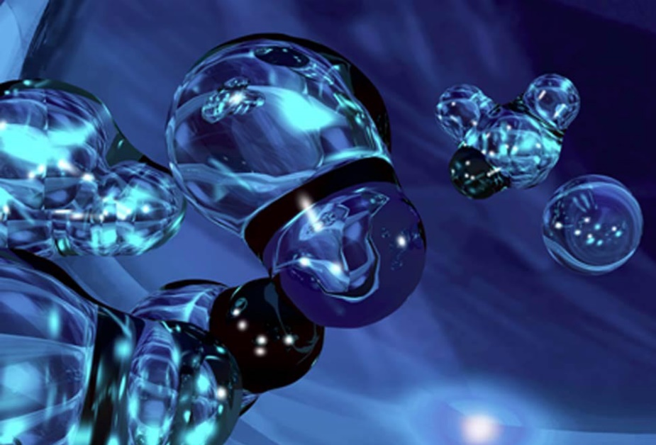
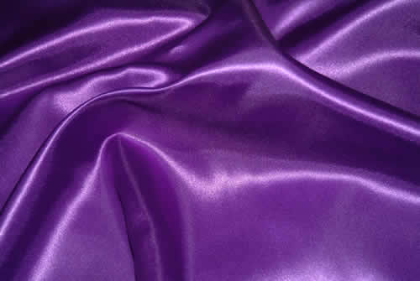
Colour & Moods
BLUE
PURPLE
Cool, elegant, sophisticated, heavenly, formal, classy, pure
Rich, pompous, regal, solitary
BACK TO MENU

Slide 26
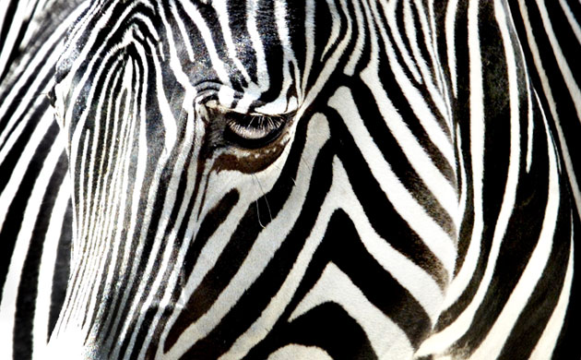
Colour & Moods
NEUTRALS
BLACK & WHITE
GREYS : natural, restful, calm, elegant, dignified, comfortable
BROWNS: natural, earthy, safe, reliable, good
Dramatic, elegant, stylish, sophisticated, pure, opposing, contrasting, clean
BACK TO MENU

Slide 27
rendering
Rendering is the process of adding tone and shade to a 2D drawing in order to make it look 3D.
Rendering is concerned with adding a sense of realism to a drawing, considering light, shade and texture.
By using coloured pencils and considering where the light source is coming from, we can turn flat objects on the page stand out and looking more realistic.

Slide 28
Tone boxes
You will learn to apply two types of tone:
FLAT TONE (for flat surfaces).
GRADED TONE (for curved surfaces).

Slide 29
Tone boxes
Shading a tone box lets you practise applying tone. Always use a sharp, soft 2B or coloured pencil for shading.
Make broad pencil stroke.
Light tones need light pressure.
Dark tones need more pressure or repeated strokes.

Slide 30
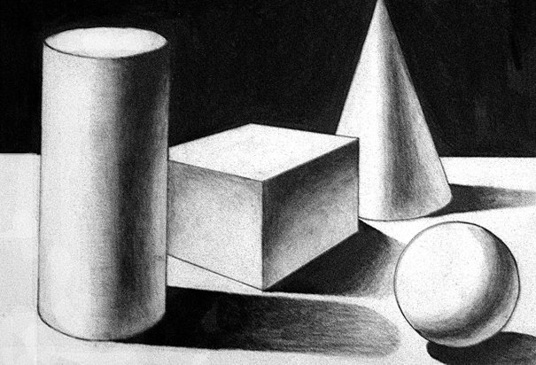
Shading and toning
Shading and toning is used to make drawings and sketches look solid and give them more form. This is done by understanding the effect that light has one the surfaces of n object.

Slide 31
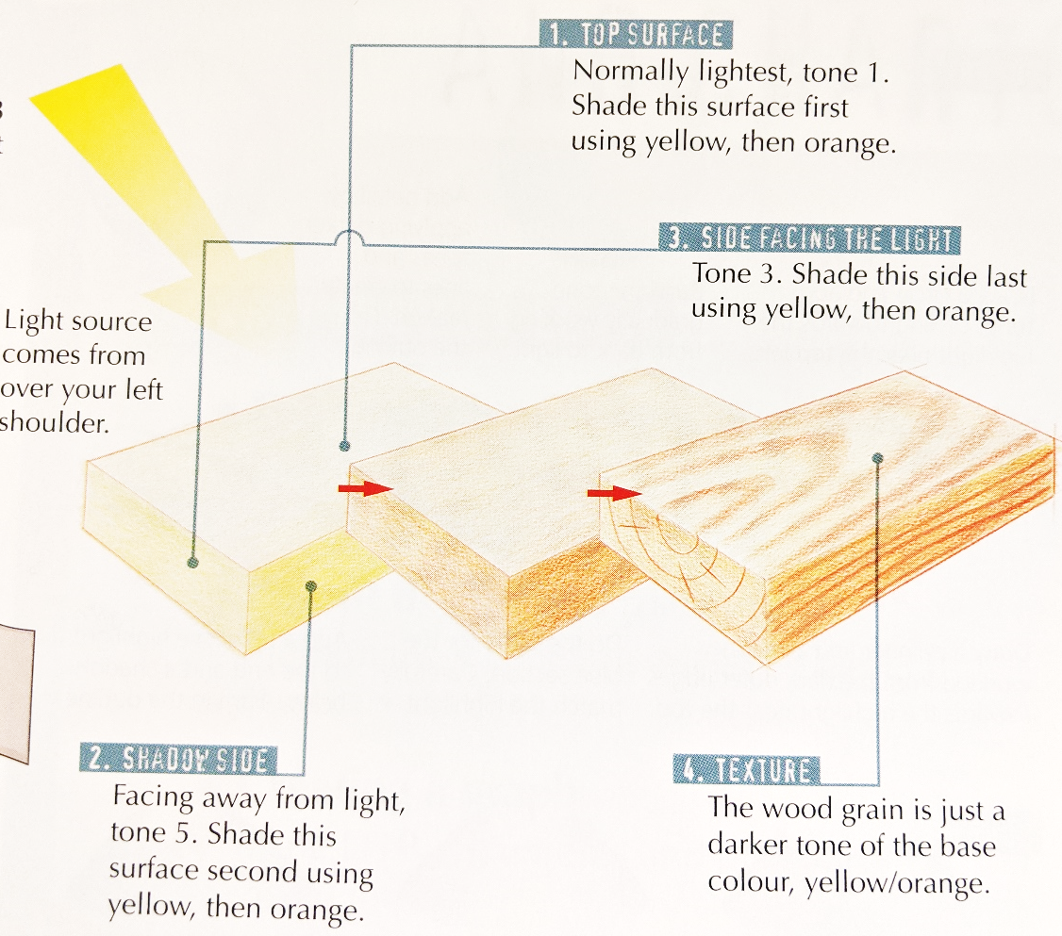
rendering
Rendering takes shading and toning one stage further: it adds texture or pattern to surfaces , suggesting a particular material or product.

Slide 32
Curved surfaces
Rendering curved surfaces requires a little more skill.
There are three main curved forms: cylinders, cones and spheres.
Attempt the following exercises to help you develop your skills.
Try to show a change in tonal scale across a curved surface. You should work from dark to light. Place your highlights carefully, usually off-centre.

